Slide 1
Employee Management System
By Urusa Qureshi
empId : 206591

Slide 2
Outline
INTRODUCTION
SYSTEM OVERVIEW
TECH STACK
FUNCTIONALITIES
CODE SNIPPETS & OUTPUTS
CONCLUSION

Slide 3
INTRODUCTION
This is a console based application designed to make managing employee records both easy and efficient.
For administrators, it simplifies the process of handling employee data, manage all employee data, while employees can update their personal details and view their profiles.

Slide 4
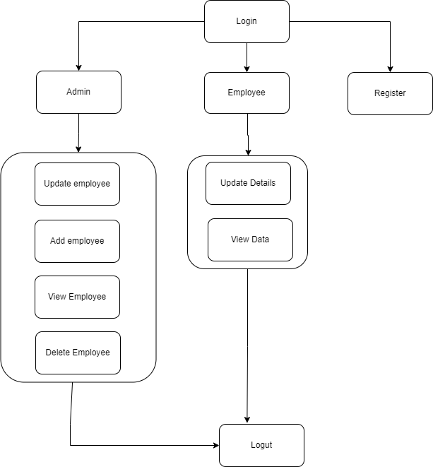
System Overview

Slide 5


Tech Stack
Language : Python
Database: MySQL
Schema : Employee(id,First Name,Last Name, email , DOJ , Role, password)

Slide 6
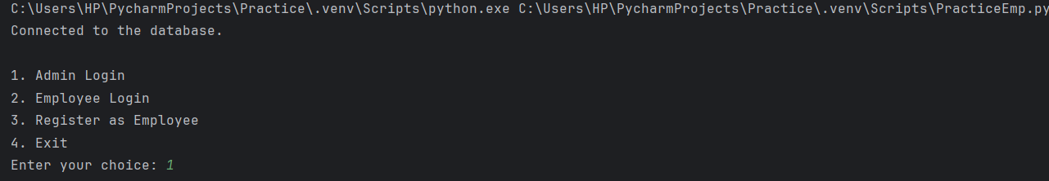
Functionalities
Authentication
Login
Admin login
Employee login
Register

Slide 7
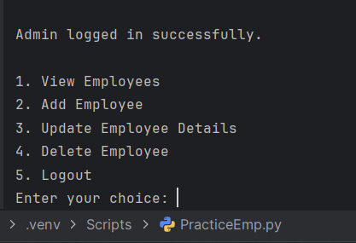
Admin Capabilities
Login: Authenticate admin credentials to access admin features.
Add Employee: Insert new employee records into the database.
Update Employee: Modify existing employee details.
Delete Employee: Remove employee records from the system.
View Employees: List all employees and their details.

Slide 8
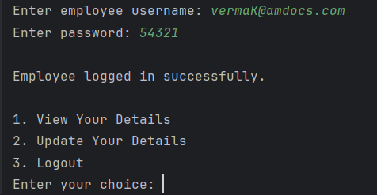
Employee Capabilities:
Login: Authenticate employee credentials to access their features.
Register: Create a new employee account (for new hires).
Update Profile: Modify personal details such as name, email, and position.
View Profile: View their own profile details.

Slide 9
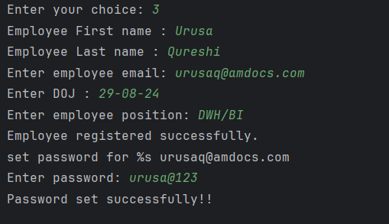
Register (INSERT) for Employee
def register_employee(cursor, connection):
fname = input("Employee First name : ")
lname = input("Employee Last name : ")
email = input("Enter employee email: ")
doj = input("Enter DOJ : ")
role = input("Enter employee position: ")
insert_query = "INSERT INTO EMPLOYEE(first_name, last_name, email, DOJ, emp_role) VALUES(%s,%s,%s,%s,%s)"
values = (fname, lname, email, doj, role)
cursor.execute(insert_query,values)
connection.commit()
print("Employee registered successfully.")
print("set password for %s", (email))
password = input("Enter password: ")
cursor.execute("UPDATE EMPLOYEE SET password = %s" , (password,))
connection.commit()
print("Password set successfully!!")

Slide 10
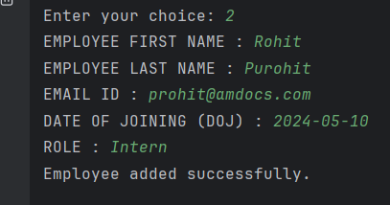
Add Employee (INSERT) for admin
def add_employee(cursor, connection):
fname = input("EMPLOYEE FIRST NAME : ")
lname = input("EMPLOYEE LAST NAME : ")
emailId = input("EMAIL ID : ")
doj = input("DATE OF JOINING (DOJ) : ")
Role = input("ROLE : ")
insert_query = "INSERT INTO EMPLOYEE(first_name, last_name, email, DOJ, emp_role) VALUES(%s, %s,%s,%s,%s)"
values = (fname, lname, emailId, doj, Role)
cursor.execute(insert_query, values)
connection.commit()
print("Employee added successfully.")

Slide 11
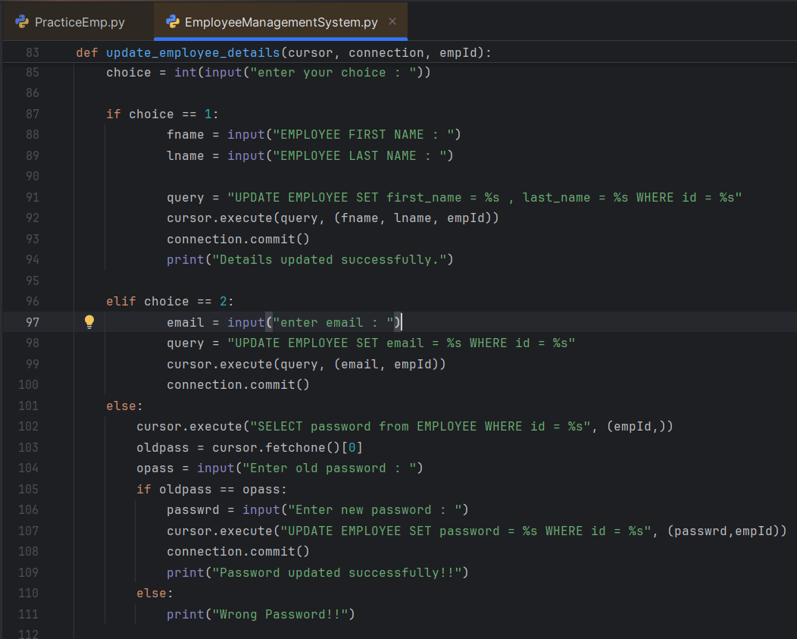
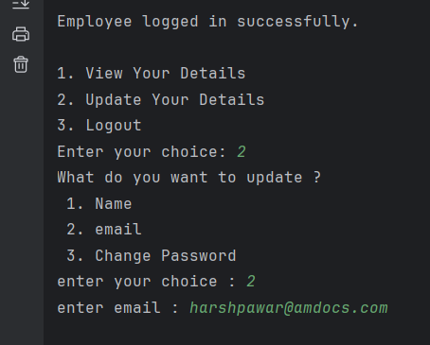
Update Employee Data (Admin & Employee)

Slide 12
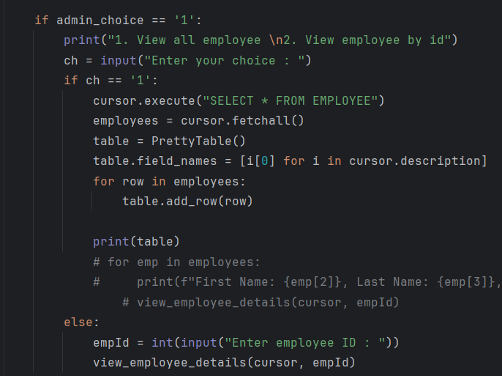
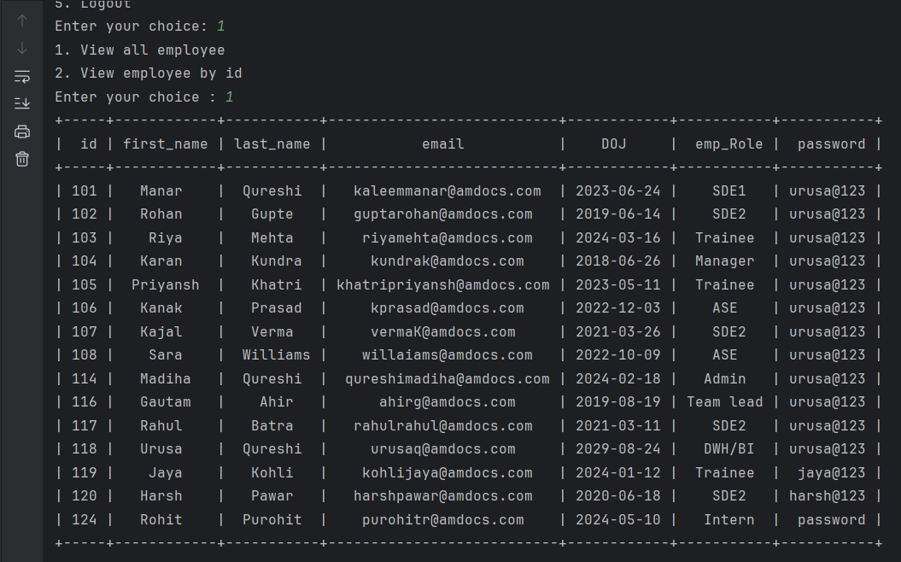
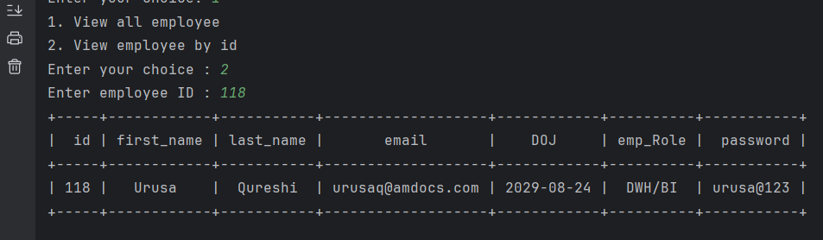
View all Employee Data (Admin)

Slide 13
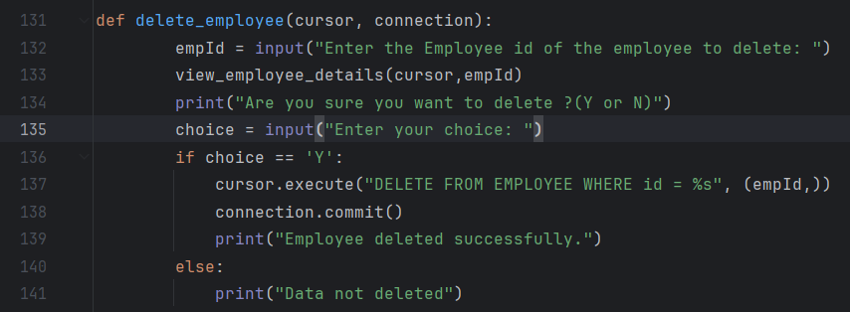
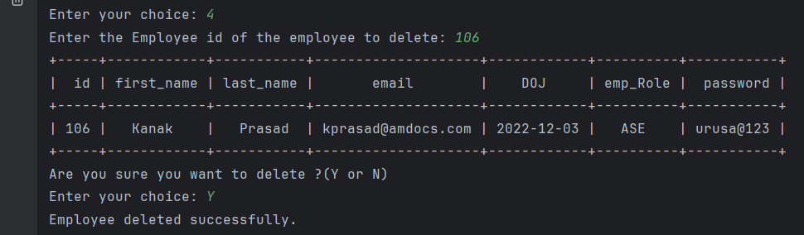
Delete Employee (Admin)

Slide 14
Conclusion
The Employee Management System is a straightforward Python-based tool that allows us to handle employee data using basic CRUD operations (Create, Read, Update, Delete). With this system, you can easily add new employees, view or search for existing ones, update their information, and delete records when necessary.
It takes the hassle out of managing employee details manually, making things faster and more organized. The system uses employee IDs to keep everything accurate and easy to track.
Overall, it simplifies the daily HR tasks, helping keep everything in order while leaving room for future improvements like reporting or performance tracking if needed.

Slide 15
THANK YOU !!

Slide 16
Questions ?

